Slide 1


EXAM PREPARATION CHATBOT

Slide 2
PROJECT DETAILS
The Exam Preparation Chatbot using RAG is an AI-powered learning assistant that transforms PDF study materials into interactive learning resources. It provides accurate answers to students' questions and automatically generates summaries, notes, flashcards, and quizzes based on the uploaded content, making exam preparation smarter, faster, and more effective.

Slide 3
TEAM ROLES & RESPONSIBILITIES
TEJAL BONDE: PDF Processing Engineer →
Developed pdf_loader.py to load PDF documents into the system for further processing.
ANJALI SHARMA: Chunking Engineer →
Created text_splitter.py and managed chunk size & overlap settings in config/settings.py.
MANYA SINGH: Embedding Engineer →
Implemented embeddings.py to generate and cache HuggingFace embeddings for document vectors.
BHAVIKA PAWAR : FAISS Engineer →
Developed vector_db.py to create, save, load, and manage the FAISS vector database.

Slide 4
NIHALI ROKADE : Retrieval & Evaluation Engineer →
Developed retriever.py and evaluation modules to retrieve relevant document chunks and measure system performance.
ANUJA PISAL : LLM & Services Engineer →
Built the shared backend infrastructure including LLM integration, prompt handling, parser, logging, decorators, and service modules.
TEJASWI SALIAN : Study Tools Engineer →
Developed AI-powered study tools including Summary, Notes, Flashcard Generator and Question Answering module.
KALPITA NAIK : Frontend Engineer →
Designed and developed the user interface using HTML, CSS, JavaScript, and app.py, integrating all backend components into the final application.

Slide 5
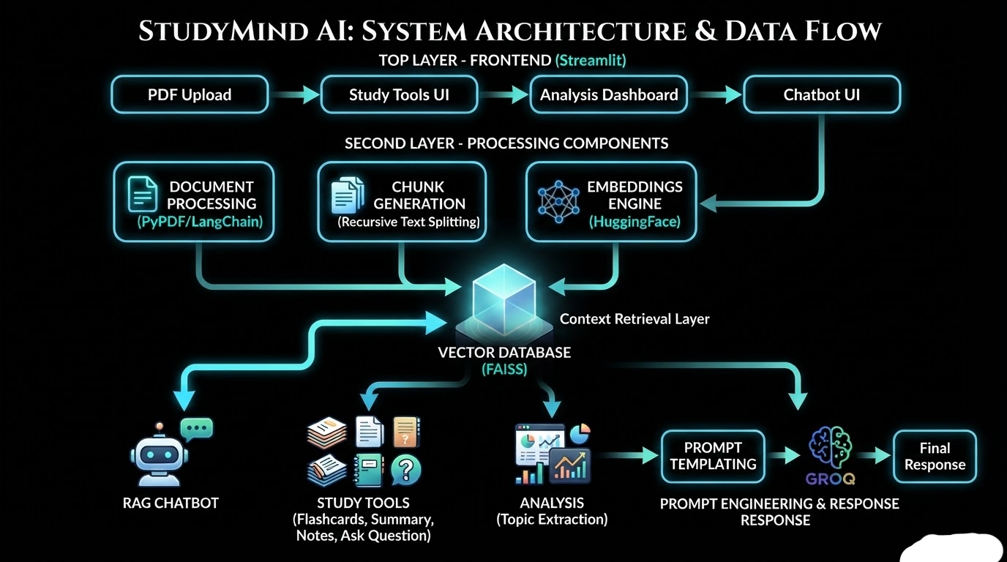
PROJECT ARCHITECTURE

Slide 6
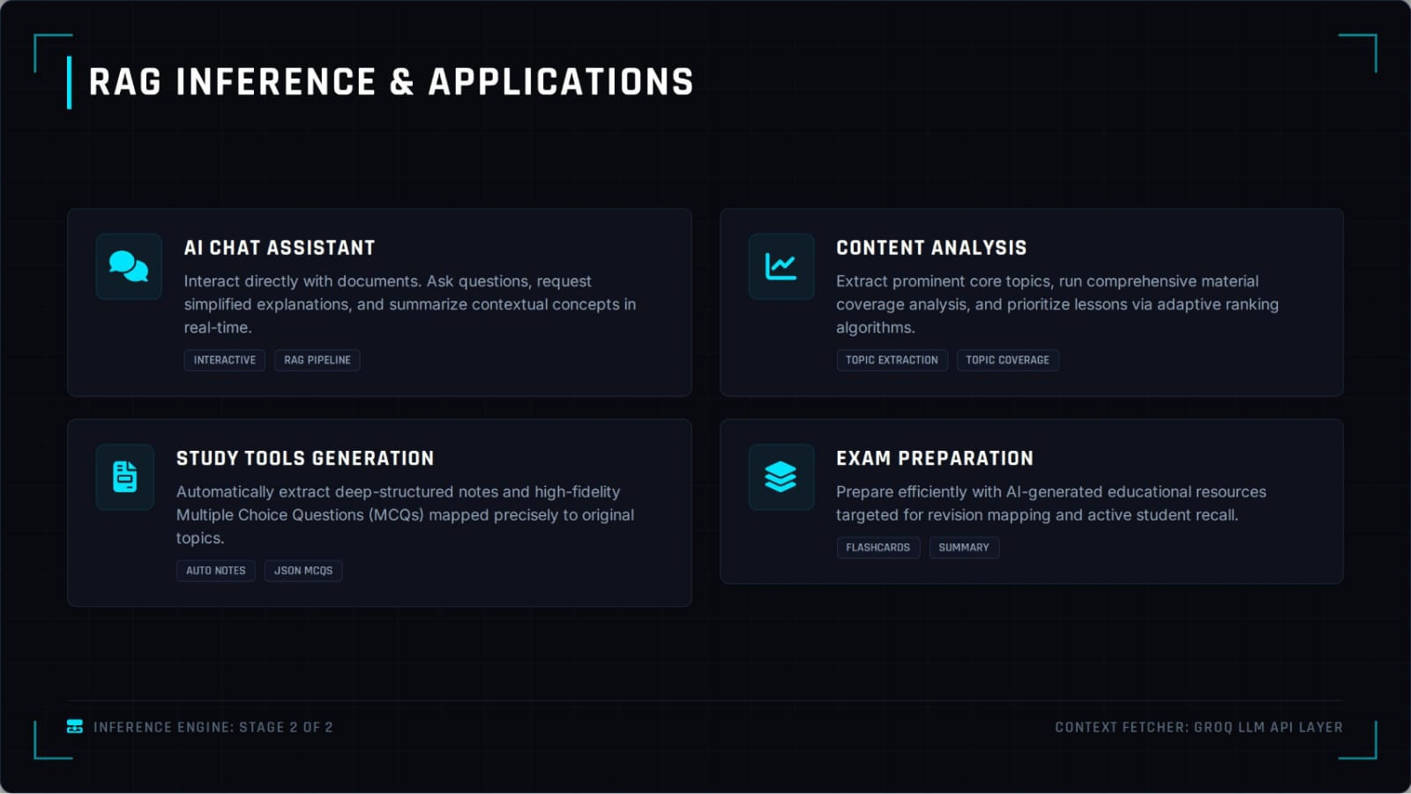
PROJECT ARCHITECTURE

Slide 7
Github directory structure
Retrieval-Augmented-Generation-RAG-for-Educational-Systems-Group99
├── app.py # Main Streamlit application
├── vector_db.py # Creates and manages the FAISS vector database
├── chatbot.py # Handles chatbot logic and RAG pipeline
├── requirements.txt # Python dependencies
├── README.md # Project documentation
├── .gitignore # Files ignored by Git
│
├── data/ # Study material (PDFs, notes, etc.)
│ ├── pdfs/
│ └── processed_data/
│
├── assets/ # Images, logos, icons
│
├── utils/ # Helper functions
│ ├── text_processing.py
│ ├── embeddings.py
│ └── helpers.py
│
├── pages/ # Additional Streamlit pages (if used)
│
└── .streamlit/
└── config.toml # Streamlit configuration

Slide 8
THANK YOU

